Slide 1
Bonus Assignment Four
CSCI3150 - Introduction to operating system
Tutor: Zhang Kai
kzhang@cse.cuhk.edu.hk

Slide 2
Overview
Task:
Implement a simple simulator of translating processes’ linear address (virtual address) to physical address using paging technique.

Slide 3
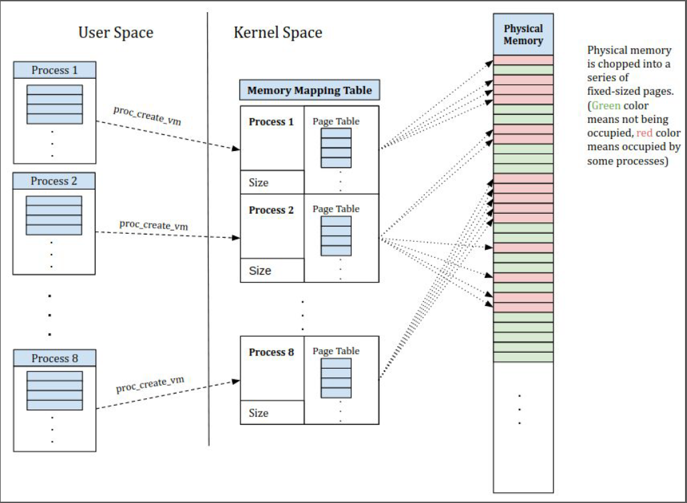
Overview
User Space
User can create (proc_create_vm) process with specified virtual memory size through the API.
User can read/write (vm_read/vm_write) the process’ virtual memory through API.
User can terminate (proc_exit_vm) process through the API.
Kernel Space
The kernel simulator maintains a page table for each process and a shared physical memory.
The kernel simulator handles the mappings from processes’ virtual memory to physical memory.

Slide 4
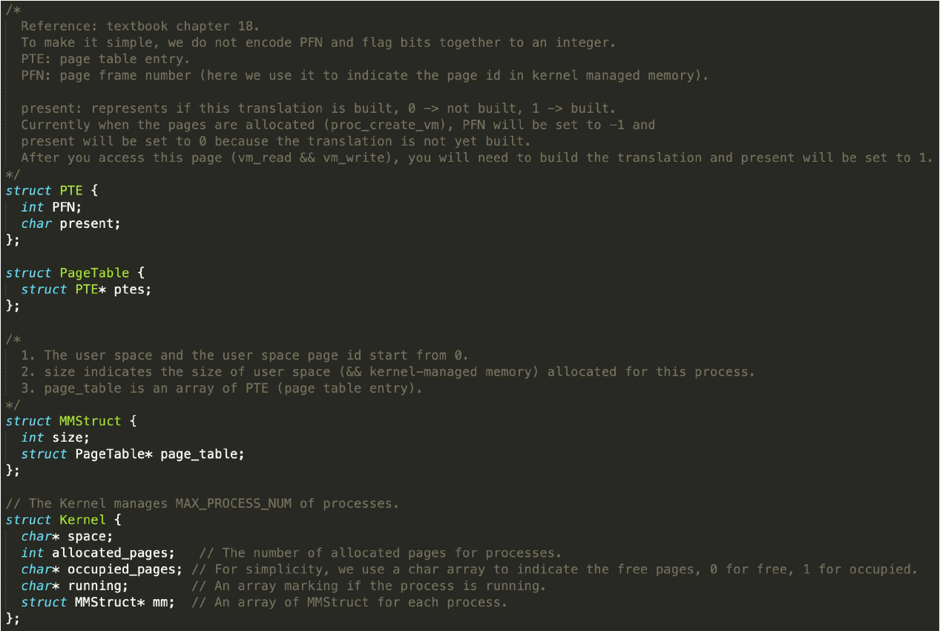
Data Structures
Kernel
space: the physical memory.
allocated_pages: Total number of allocated pages for all running processes.
occupied_pages: char array (size is the number of kernel pages) to indicate the free pages, 0 -> free, 1 -> occupied.
running: an array marking if the corresponding process is running.
mm: an array of page tables.
Array of MMStruct

Slide 5
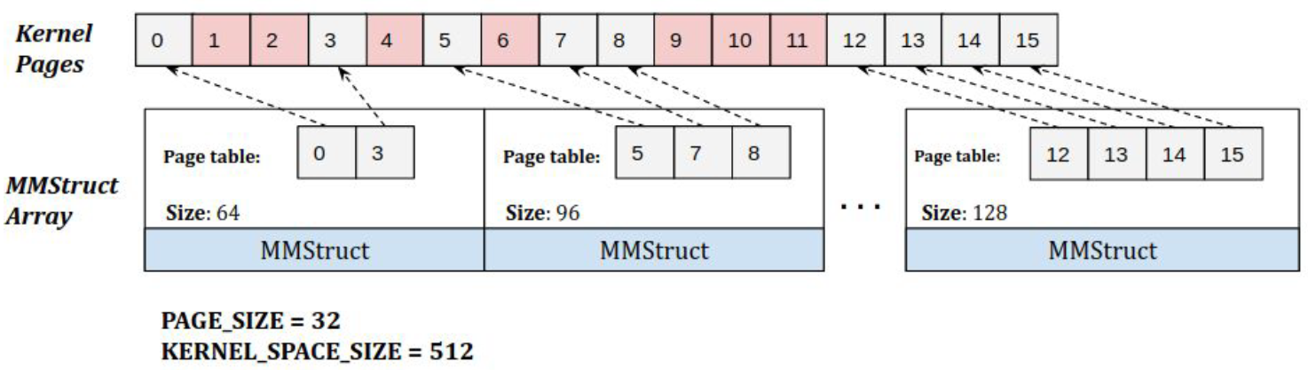
Data Structures (Cont'd)
MMStruct:
size determines the number of allocated pages.
page table contains an array of PTEs.

Slide 6
Implementation
Task: Totally 4 functions (API) in the kernel.c need to be implemented.
1. int proc_create_vm(struct Kernel* kernel, int size)
1.1. Check if a free process slot exists (check the running, the slot will be the pid returned).
1.2. Check if there's enough free space (check allocated_pages).
1.3. Allocate the space for page_table (the size of it depends on the pages you needed. e.g. if size=33 and PAGE_SIZE=32, then you need 2 pages) and update allocated_pages.
1.4. The mapping to kernel-managed memory is not built up, all the PFN should be set to -1 and present byte to 0 (PTE) and set the corresponding element in running to 1.
1.5. Return the pid if success, -1 if failure.

Slide 7
Implementation (Cont’d)
2. int vm_read(struct Kernel* kernel, int pid, char* addr, int size, char* buf)
2.1. Check if the reading range is out-of-bounds.
2.2. If the pages in the range [addr, addr+size) of the user space of that process are not present, you should firstly map them to the free kernel-managed memory pages (first fit policy: scan from the beginning).
3. int vm_write(struct Kernel* kernel, int pid, char* addr, int size, char* buf)
4. int proc_exit_vm(struct Kernel* kernel, int pid)
4.1. Reset the corresponding pages in occupied_pages to 0.
4.2. Release the page_table in the corresponding MMStruct and set to NULL. Return 0 when success, -1 when failure.

Slide 8
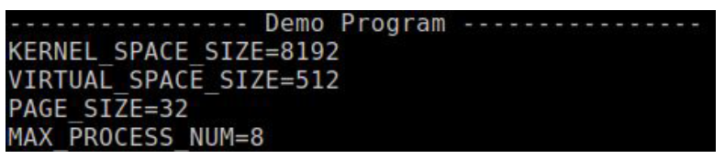
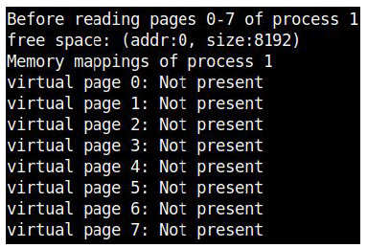
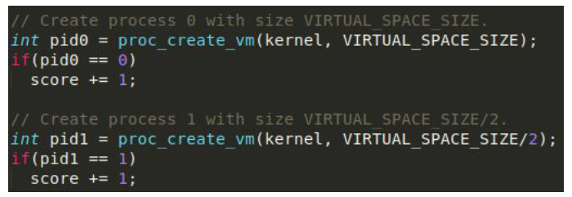
Demo
You can find the demo program in demo.c
Initial parameters
Create process 0 and 1

Slide 9
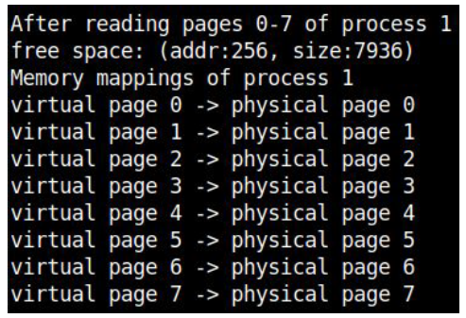
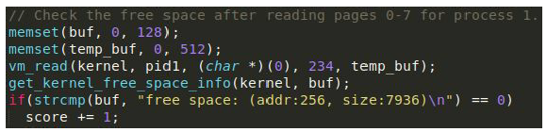
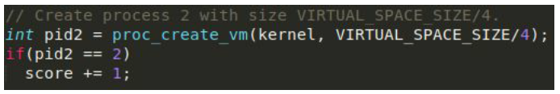
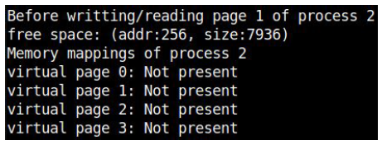
Demo (Cont’d)
Read page 0-7 of process 1
Create process 2

Slide 10
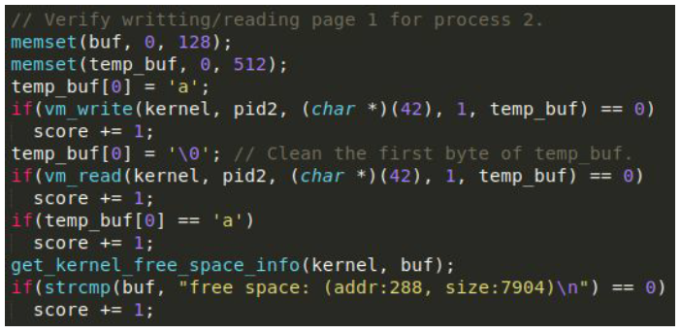
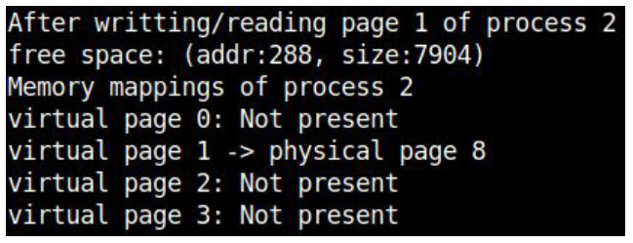
Demo (Cont’d)
Write and read the page 1 of process 2

Slide 11
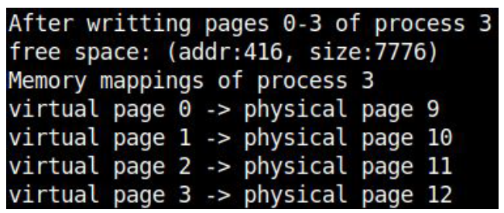
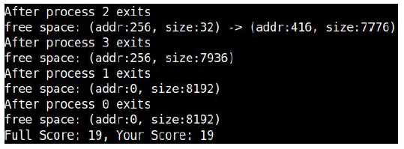
Demo (Cont’d)
Create process 3 and write page 0-3 of process 3
Exit

Slide 12
Submission
After you finish bonus assignment four, please only submit the kernel.c to Blackboard.

